Slide 1

Intro to machine learning: Model Selection and Evaluation

Slide 2

Final Assignment clear?
If not: Re-iteration of the requirements: Walkthrough of template script and final assignment page

Slide 3

When to use which ML Algorithm?

Slide 4
When to use which ML Algorithm?
Choose a problem/thing you want to predict
Categorize it
By input:
Labelled? → Supervised learning: Linear, logistic regression, Decision tree, KNN
Unlabelled? → Unsupervised learning: K-Means Clustering
By output: Outcome (Y)
A number? → Simple & Multiple Linear Regression
A class? (0,1) → Logistic Regression, Decision Tree, KNN, K-Means Clustering
Both? → Decision Tree
Use the above to fill in the following sentence:
I’m going to predict [outcome variable]. My data is (un)labelled because I (don’t) know all real values of my outcome variable. My outcome variable is a number/class and therefore I can use the [ML algorithms feasible] to predict my [outcome variable]. Because [arguments for a specific ML al
gorithm’s suitability], I will choose [ML algorithm of choice].

Slide 5

How to evaluate your model?

Slide 6
Linear regression
Predicting a number (numerical data)
Labelled: we know the actual values
Goes for both simple and multiple linear regression

Slide 7
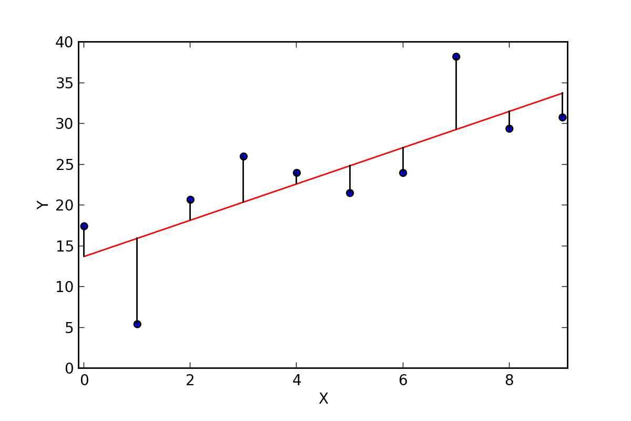
Evaluating Linear regression
Evaluating a linear regression model means measuring how good it is at predicting the problem/thing you want to predict.

Slide 8
Evaluating Linear regression
Plot of Predicted Values VS. Actual values: how good your model is at explaining visualised
A visual measure of
goodness of fit:
how good do my data
points resemble the
original pattern?

Slide 9
Evaluating Linear regression
Mean-Squared Error: the (squared) average difference between your predicted value and the actual value
An error = predicted value(x) – Actual value(x)
E.g. When x =1: Error= 15 – 5 = 10
MSE = mean of (all errors^2)
E.g. You have the Errors = 2, -3, 4
Mean(2^2, -3^2, 4^2)
Mean(4, 9, 16) = 29/3 = 9,667

Slide 10
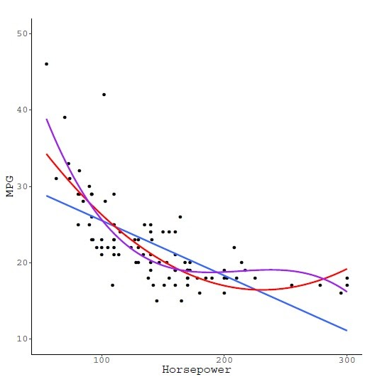
Evaluating Linear regression
R-Squared: the percentage of variation explained in the data (a.k.a. how good your model is at explaining)
A measure of goodness of fit:
How close can I get to a perfect
prediction?
When 1 is perfect (fit) and 0 bad (fit)

Slide 11




But what about classification models?

Slide 12
But what about classification models?
Logistic Regression
Decision Trees
K-Means Clustering
Use the provided Notebook!
_____[Click to download]_____

Slide 13

Any questions?

